Slide 1
Highlights of the Report

Slide 2
Why Think Tanks?
It is widely acknowledged, especially in the global South, that governments do not have adequate capacities to carry out comprehensive research on public policy problems in terms of their root/source, scale and possible options to tackle the problems.
The failure to adequately comprehend a problem largely leads to waste in an environment of scarcity further inhibiting progress.

Slide 3
Context: Policy Making in Africa
Often policy making across many African countries is shrouded in secrecy
The entire process tends to be 'mystified' and is mostly dominated by elite sections of political society
Civil society-based policy research and advocacy capacity Think Tanks have not yet had any significant impact on policymaking.
The policymaking process has not yet been fully opened to utilize research findings and policy proposals generated by civil society based African Think Tanks
Limited trust between Think Tanks and governments

Slide 4
Zimbabwean Context Crisis
Table 1: Summary of Zimbabwean Crisis
Dimension | Characteristics of the Crisis
Economic Aspects of the Crisis | High Levels of Unemployment Hyperinflation International isolation (sanctions) Weak or no economic growth as measured by Gross Domestic Product (GDP) De-industrialization/Closure of Companies Poor Capacity Utilisation Collapse of infrastructure High prices of goods Cash shortages Weak demands over goods
Agriculture | Contestations over land reform and disagreements overcompensation model Land Reform induced decline/collapse of agricultural performance (2000-2008) Food crises/increase in number of food insecure households Shrinking of land under irrigation Shortage of productive inputs Climate change induced challenges
Social: Health | Shortage or unavailability of essential drugs Shortage of machinery to carry out basic procedures Skills Migration (All health care personnel) Poor remuneration for Doctor and Nurses
Social: Education | Growth in population not matched by increase in education infrastructure High levels of teacher absenteeism Skills migration of highly qualified professionals Poor remuneration of teachers Shortage of textbooks Increasing numbers of school dropouts
Social: Housing | Weak or no supply of low-priced housing stock Increasing number of families on housing waiting lists Weak financing mechanisms to support supply of housing especially for Bottom of Pyramid (BOP) based households Increasing prices of stands Increasing number of people living in informal settlements
Political and Governance | Polarization High levels of intolerance towards dissenting views Weak or no respect for the rule of law Failure to manage succession within political parties Abuse of electoral processes Election based/related violence Increase in the number of citizen-based protests on government actions
Table 1

Slide 5
Definition
The term ‘Think Tank’ covers a broad set of policy research organisations which focus on ‘producing or using research to inspire, inform or influence policy across various areas of interest’.
It is important to note that Think-Tanks everywhere have become dynamic and are not necessarily confined to the traditional policy-research space but have extended the realm (Perez-Leon, 2016).
They are different across regions and have evolved and responded to the different contexts and realities, thereby broadening their definition.

Slide 6
Do we have Think Tanks?
a) Think Tanks by Country
b) Top 100 Sub-Saharan Africa Think Tanks
Country | Numbers
South Africa | 92
Kenya | 56
Zimbabwe | 26
Nigeria | 51
Ghana | 38
Country | Number
South Africa | 4
Ghana | 3
Kenya | 2
Botswana | 2
Zimbabwe | 2

Slide 7
Relationship between TTs and Govts
Disconnected
“there exists a disconnect between the policy making process and the considerable base that policy researchers are producing that is, full use is not being made of research findings generated in Africa when decision makers formulate policies”
Limited interest in local knowledge
“ One of the features of agriculture policy analysis and strategic investment planning in Africa has essentially been dominated by expatriate consultants and academics. As a result, valuable experience has been accumulated by a large number of people from outside the continent (ODI Nepad, 2010:17)”

Slide 8
Self Introspection
Could it be that local Think Tanks also have inadequacies that they need to address?
Are they fit for purpose?
It is important to note that local Think Tanks’ responses to government’s weak policies can at times be equally inadequate, very formulaic and, quite frankly, at times fail to create viable alternatives.
For e.g- the continent has gone through campaigns for budget literacy, especially with women’s lobby groups demanding gender sensitive budgets. This was followed by the ‘percentage’ movement: 15% for Education, 10% for Agriculture, etc.

Slide 9
Self Introspection cont’…
At the same time Africa was losing close to US$60 billion annually through illicit financial flows and very few in civil society were addressing this problem
Most civil society-based Think Tanks work in rigid silos.
These silos have developed around how organisations positioned themselves and were perceived;
Widely acknowledged but not openly discussed – competition for donor funding has discouraged a more collective approach to solving policy problems
There are divisions between purely for research, policy reform/advocacy and service delivery, between Think Tanks and advocates of change

Slide 10
Our Method
 | Name of Think Tank | Focus Areas
1. | ZIMCODD- Zimbabwe Coalition on Debt and Development | Social and economic rights, Public finance management, Natural resource governance, Trade justice and livelihoods, Movement building, Organisational development
2. | NAYO- National Association of Youth | Development, Civic activism, social participation, mainstreaming
3. | LEDRIZ- The Labour and Economic Development Research Institute of Zimbabwe | Advocacy and engagement, economic literacy/socio-economic rights, women and gender,
4. | SMAIAS- Sam Moyo African Institute for Agrarian Studies | Independent research institute that works with key actors throughout Africa to enhance capacity to develop and implement equitable agrarian policies and promote sustainable land use in support of marginalised groups through undertaking research, policy analysis, training and dialogue
5. | SEATINI- The Southern and Eastern Africa Trade Information and Negotiations Institute | Trade and food security and sovereignty, Mining and agriculture, Women initiatives, Global Health initiatives
Through a desk-top study, we identified 24 organisations that we deemed to fit the criteria/label of local Think Tanks.
These are mostly organisations that carry out policy focused research, organise policy focused convenings, carry out advocacy and/or engage in policy focused training.
Table 4

Slide 11
 | Name of Think Tank | Focus Areas
6. | INSAF- Institute for Sustainability Africa | INŚAF strives to transform people, organisations and institutions towards sustainable economies, development and living in Africa through fostering research and policy, programmes and knowledge sharing.
7. | RAU- Research and Advocacy Unit | Citizen agency through research and advocacy, Governance issues, Constitutionalism, Gender, Youth
8. | ZEPARU- Zimbabwe Economic Policy Analysis and Research Unit | Economic policy analysis and research, influence policy making and provide information to the public
9. | ZDI- Zimbabwe Democracy Institute | The ZDI focuses its research in democratization, good governance, political finance and economic governance, public policy, human rights and transitional justice, media and democracy relations, socio-economic policies; electoral studies and Zimbabwe’s foreign affairs.

Slide 12
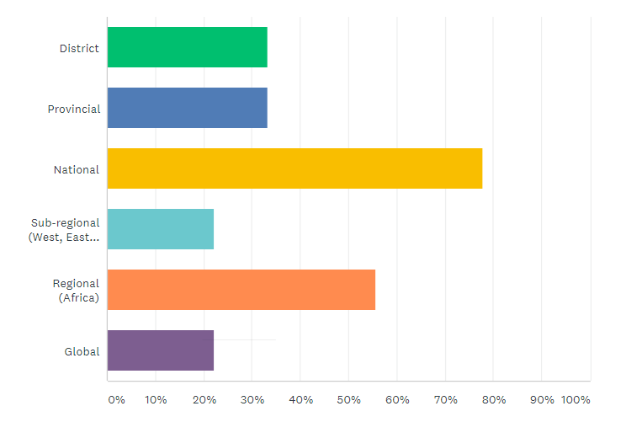
Think Tanks’ Geographic Focal Areas?

Slide 13
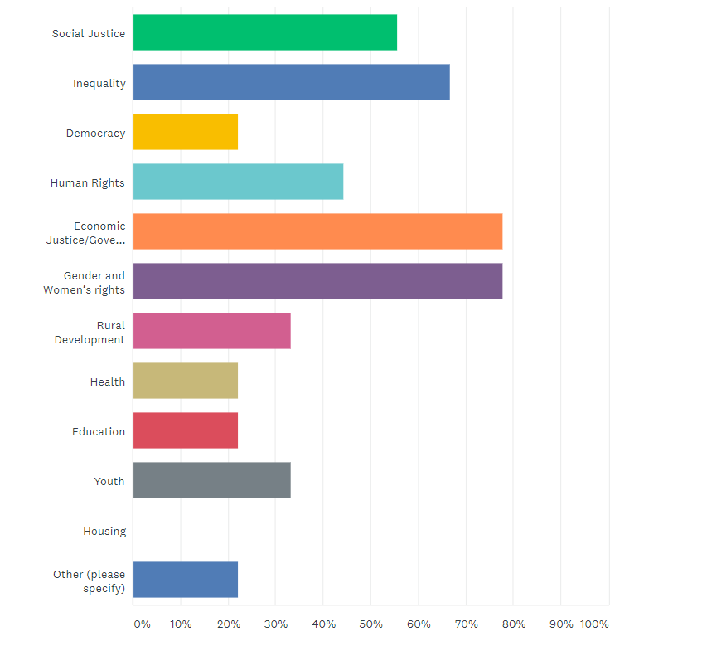
Think Tanks’ broad areas of focus as defined by their strategy

Slide 14
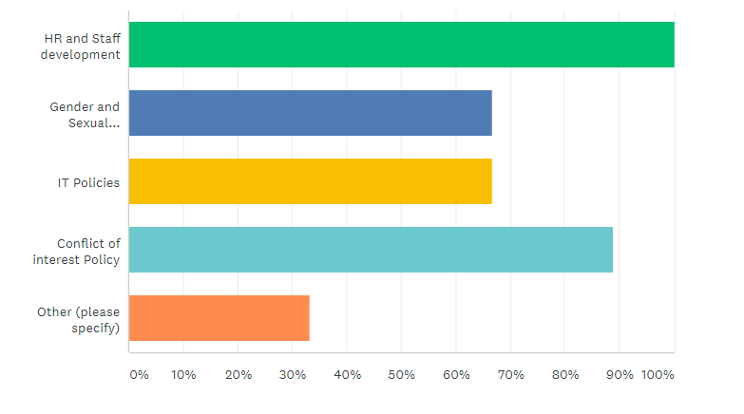
Policies in place within Think Tanks

Slide 15
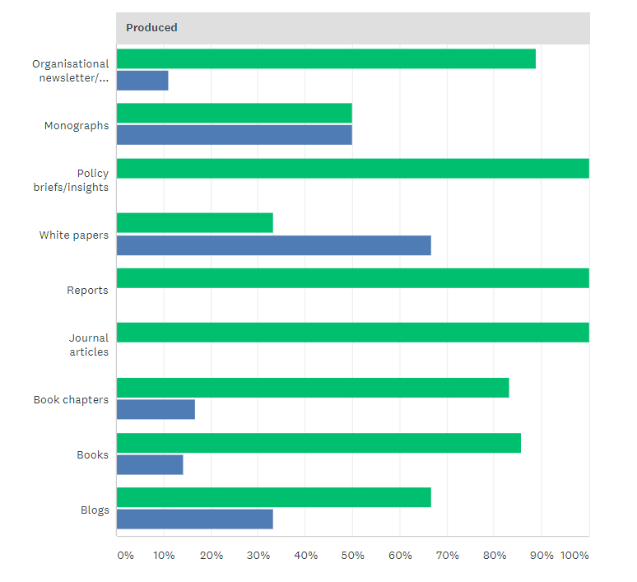
Types of Knowledge Products Produced

Slide 16
Initial Identification of Think Tanks to study
The first stage of the study involved undertaking an audit of Think Tanks currently practising in Zimbabwe
Challenges
Some Think Tanks have outdated information on their websites
Some of their websites have currently stopped working/cannot be found
Some Think Tanks are inactive/have been inactive mainly due to lack of funding
Some Think Tanks’ organisational structures have rendered them ineffective and hence invisible within the space
Some Think Tanks outside of Harare that were approached for the survey could not respond to the questionnaire even by the time the report was compiled, rendering the report ‘Harare centric’.

Slide 17
Key Trends
1. Declining Core Funding
2. Shifting balance of Power Between Think Tanks and the State
African Think Tanks also often face co-optation either from political parties or from the central government.
New democracies or regimes often offer Think Tank leaders a seat at the table if the Think Tank leaders are not part of the system already.
3. Emerging Alternative Disruptors
Organisations that focus on new research methods such as Behavioural Economics
Organisations that leverage technology
Organisations that fluctuate between not-for-profit, for-profit or new media business models and do not necessarily want to be viewed as Think Tanks, yet they fill the same space as Think Tanks

Slide 18
Summary Lessons and implications for a future framework
3. Collaboration
2. Knowledge Generation
4. Impact Measurement
Key Insights & Future Suggestions/ Future Framework
1. Financial Sustainability
5. Context Adaptation

